Slide 1

Microsoft Movie Analysis
Daniel Journic
22 November 2020

Slide 2
Summary
Analysis of movie data to provide insight into Microsoft’s entry into the movie industry:
Sequels (3rd or higher) make up the majority of the highest grossing movies ever
Movies based on video games have made a lot of money
As the franchise continues, it makes more money
Microsoft owns a few franchises that can easily be turned into a movie series

Slide 3
Outline
Business Problem
Data and Analysis
Results
Conclusions

Slide 4

Business Problem
Microsoft wants to enter the movie market:
What movies make the most money
What Microsoft properties are most valuable
How can Microsoft best capitalize on them

Slide 5
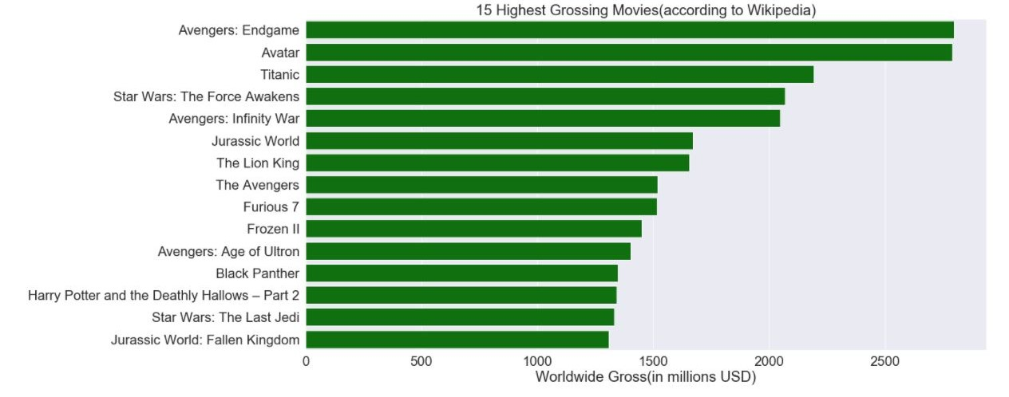
Data:
The top 15 highest grossing movies of all time, according to Wikipedia. 11 of the 15 movies are sequels. In fact 8 of them are 3rd or higher in the series.

Slide 6
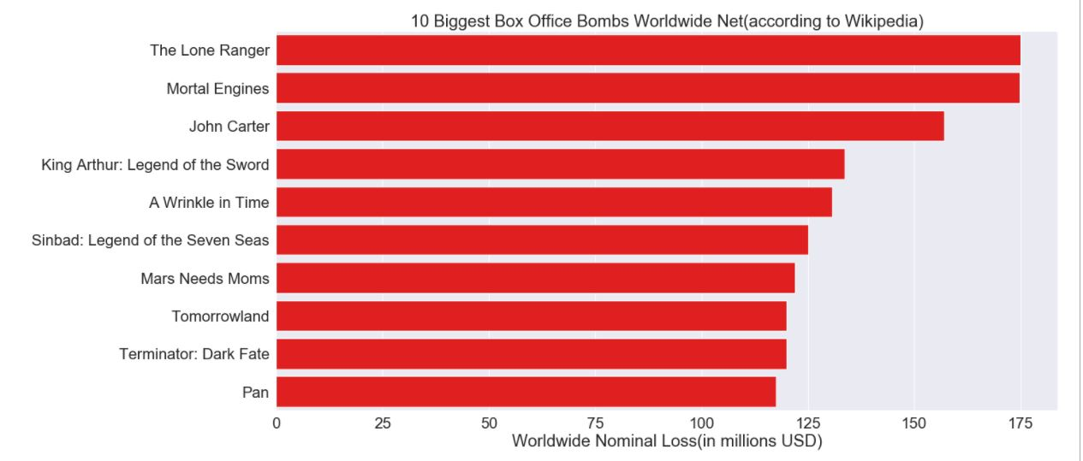
Originals
This graph shows the worst bombs of all time. Only 1 of these movies is a sequel.

Slide 7
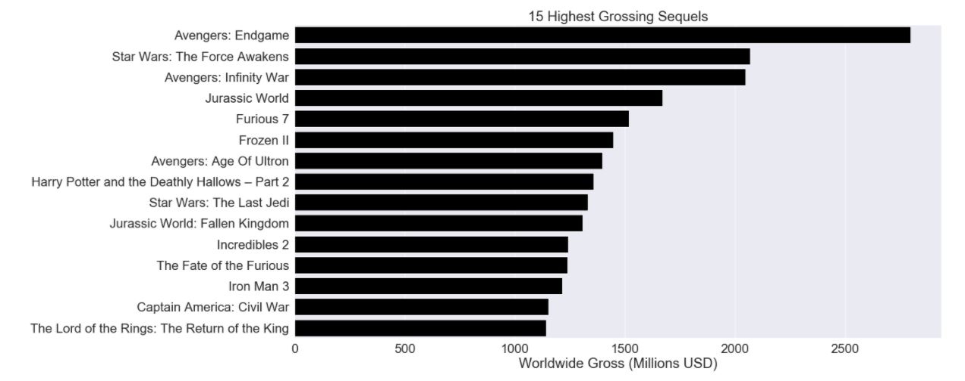
The highest grossing sequels of all time. Only 2 of them are the first sequel, the rest are at least the 3rd in the series.

Slide 8
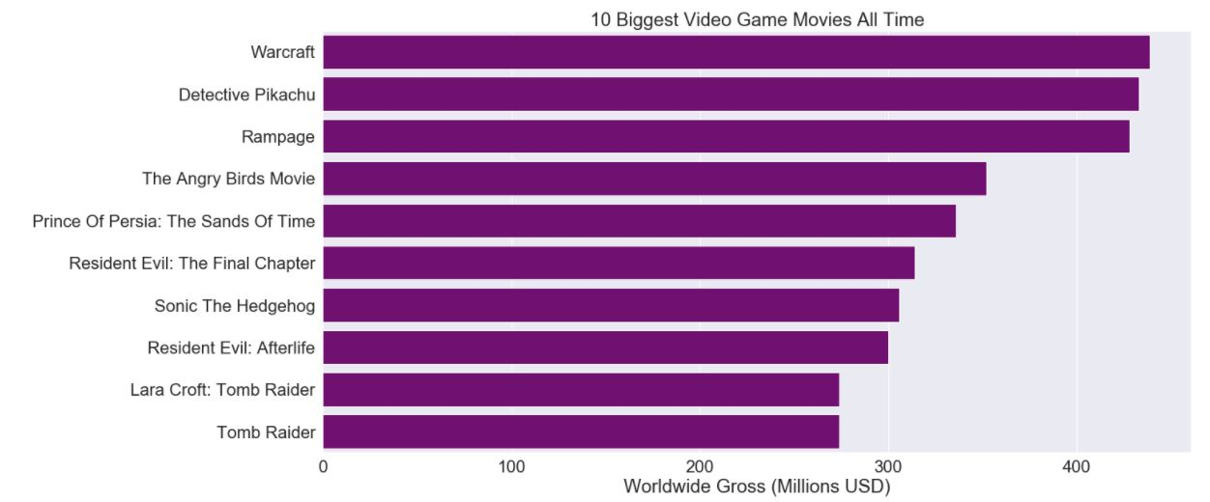
The highest grossing video game movies of all time. Notice that 2 of them are in the Resident Evil series.

Slide 9
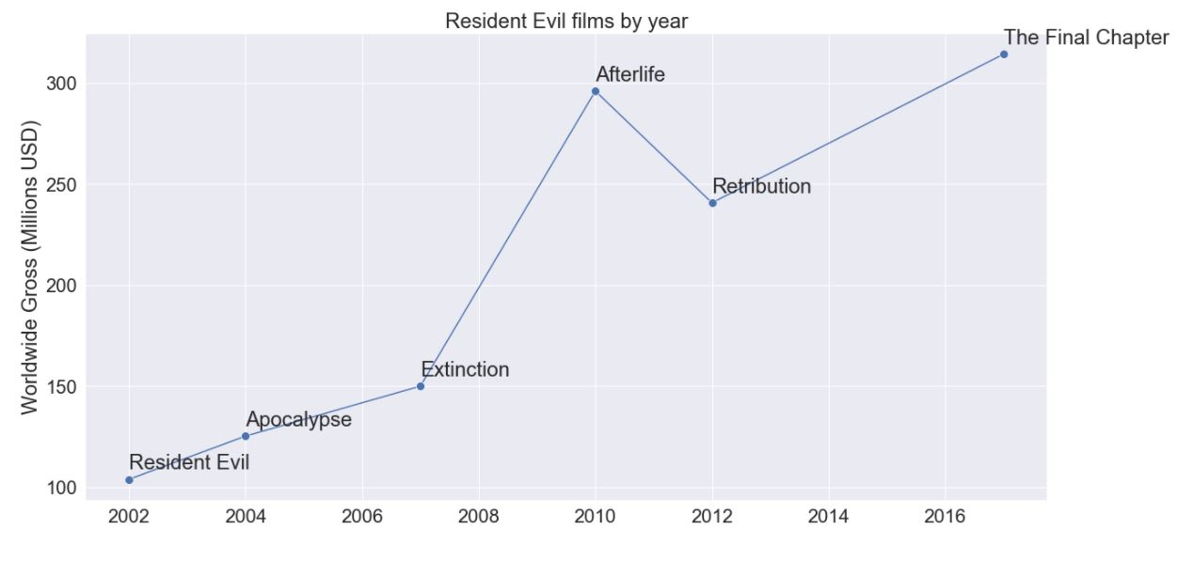
4 out of 5 of the Resident Evil movies made more than its predecessor, and all of them made more than the original.

Slide 10
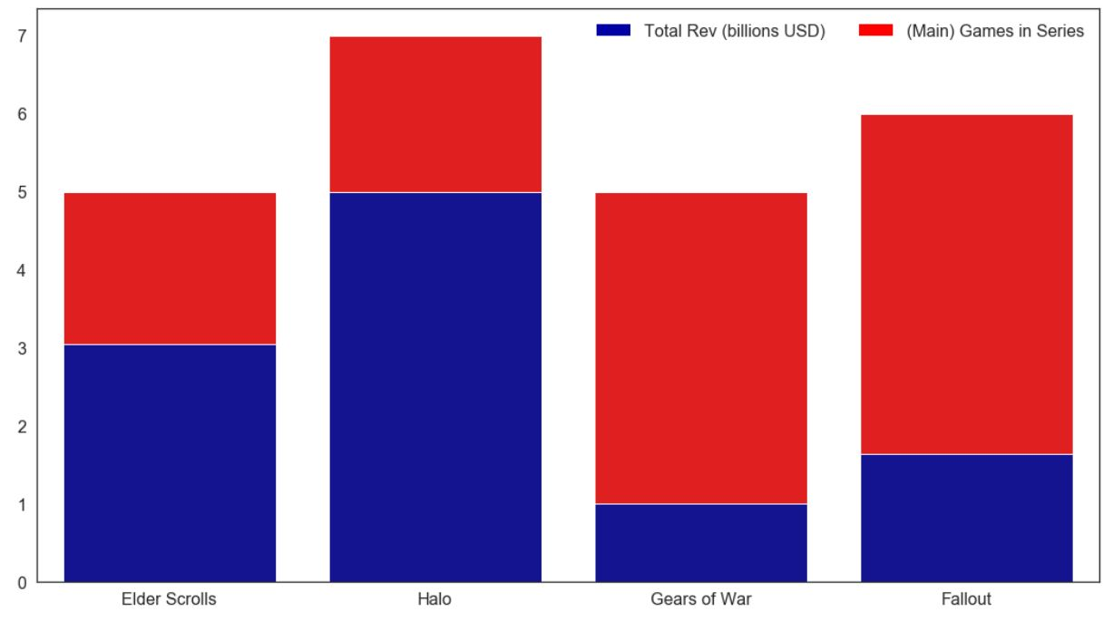
Microsoft owned properties
This graph shows the revenue of some of Microsoft’s most profitable franchises

Slide 11
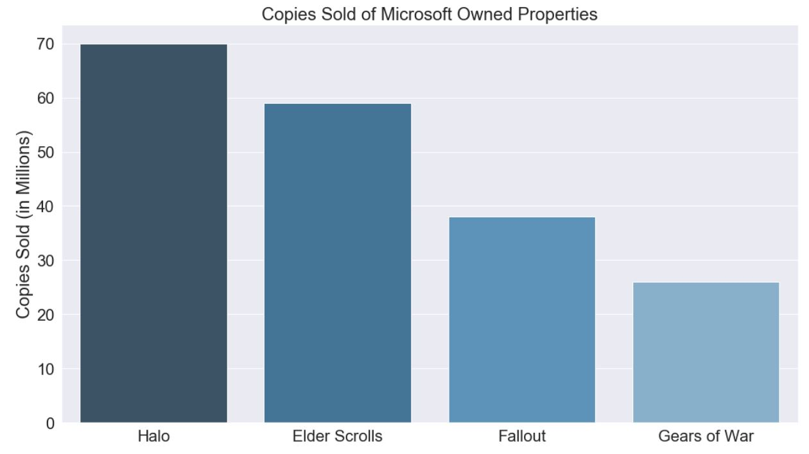
Conclusion:
Microsoft has access to at least 4 different billion dollar properties
Sequels (and further) tend to do better than the originals
In order to maximize profits they should invest and commit to making a series of movies.

Slide 12
Conclusion:
Sequels (3rd or higher) are among the most financially successful movies of all time.
Movies tend to make more money as their series progresses
Microsoft owns some multi-billion dollar franchises they can easily turn into movies
Further considerations:
Other movie franchises and how they’ve done with successive movies
How movies with similar stories have fared against each other

